Slide 1
Predicting Used Car Prices From Craigslist Data
Colby Watts

Slide 2

Motivation
Cars are a big part of daily life
Expensive purchases
Used car prices vary greatly
  Want to ensure we’re getting the best deal
A price bin-classifier helps identify overpriced or underpriced listings

Slide 3
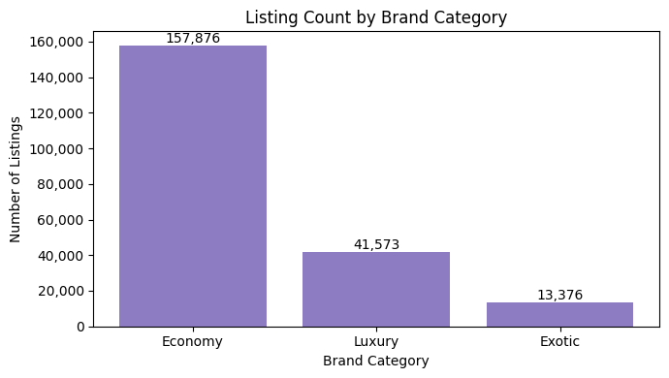
Dataset overview
Kaggle dataset of Craigslist listings from April-May 2021
426,000+ rows, 26 columns
  Year, make, model, odometer, condition, cylinders, transmission, etc.
  MANY null/wrong values
209,000 rows after data cleaning

Slide 4
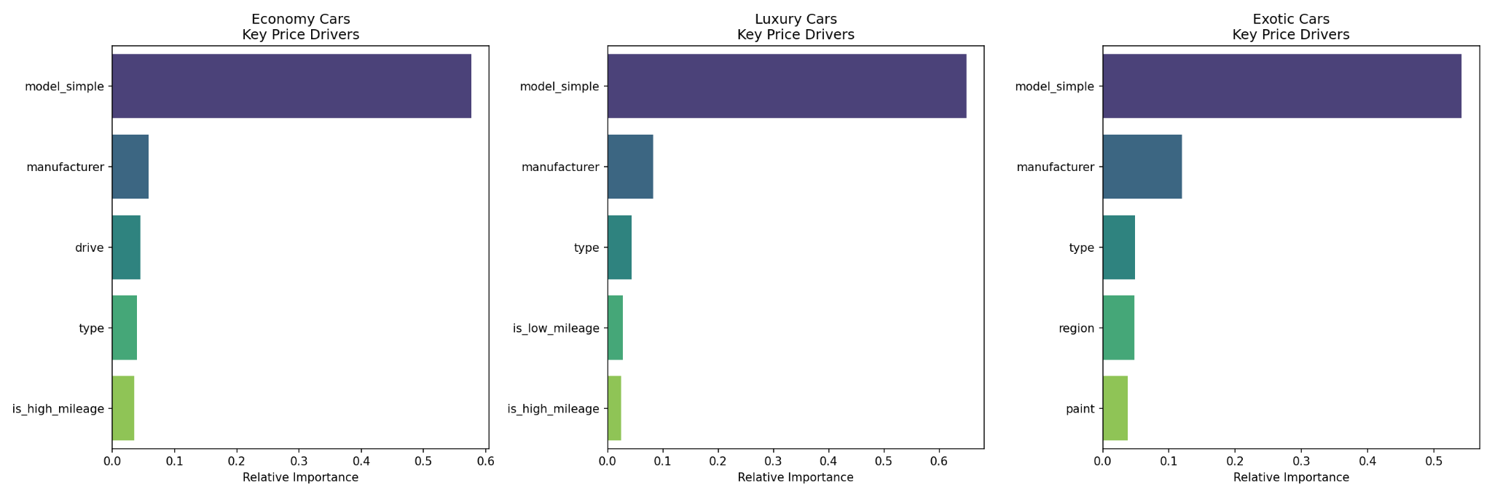
Dataset overview

Slide 6
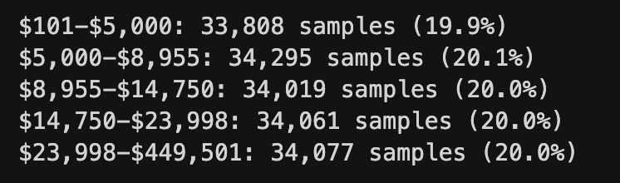
Classification Setup
Created 5 price bins representing ~20% of the dataset each
Predicted a price bin for each vehicle
Tried several different models

Slide 7
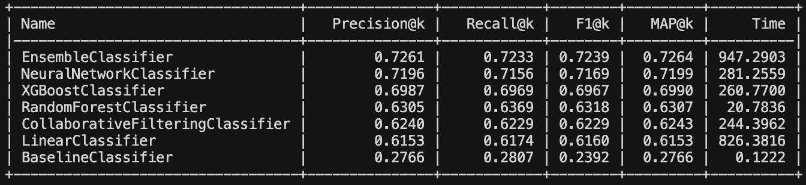
Model Selection
Best standalone model was a neural network
  Good at finding non-linear relationships
    “Miles affects price much more on an exotic car than an economy car”
Decided to create an ensemble model
  Neural Net, XGBoost, Collaborative Filtering
  Fixes blind spots in each individual model

Slide 8
Evaluation
Evaluated each model using precision, recall, F1, MAP
  Mainly concerned with precision
Ensemble model is able to predict the correct bin 72.6% of the time
  Good considering baseline is 27.6%

Slide 9
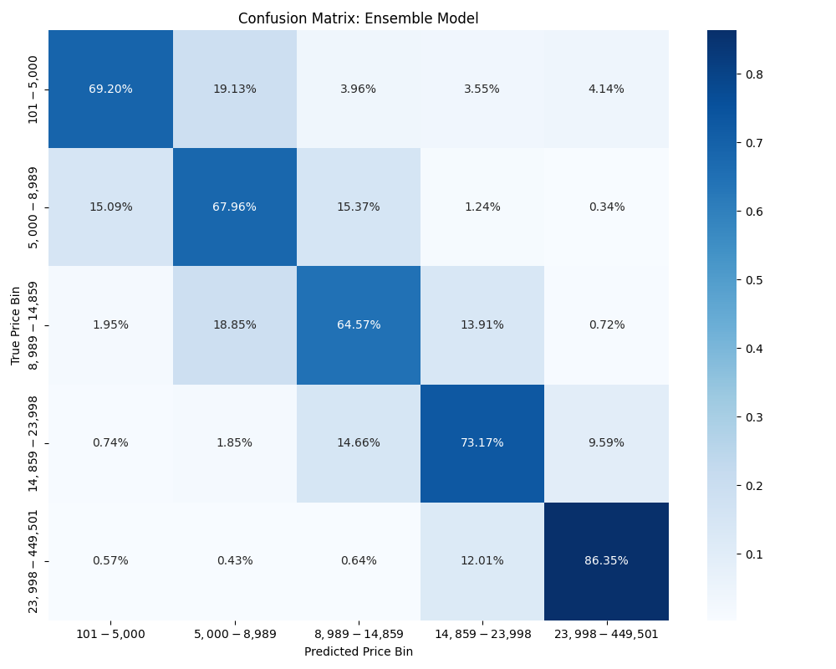

Slide 10
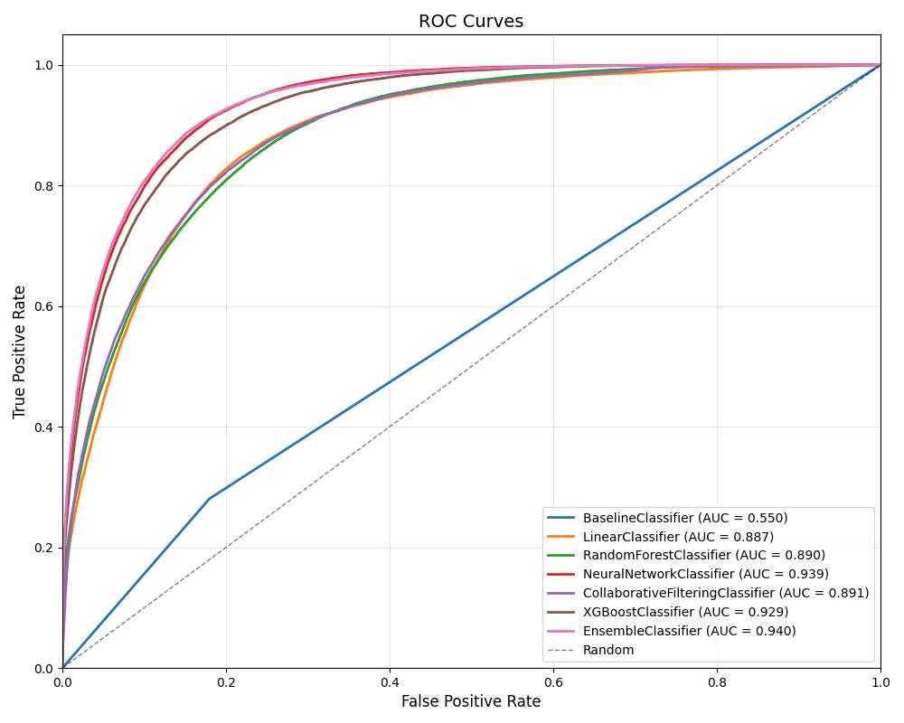

Slide 11
Thank You!

